Slide 1
Process Excellence in DuPont
Supply Chain Transformation
Global Benchmarking Council
November 2004

Slide 2

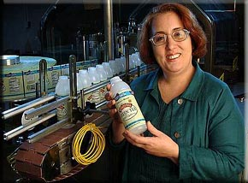
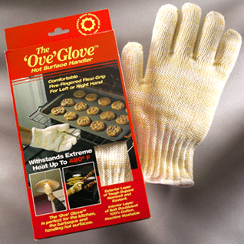


Our Vision
To be the world’s most dynamic science
company, creating sustainable solutions
essential to a better, safer, healthier life
for people everywhere.
Notes:
Our vision for DuPont is articulated on this chart.
It includes the three elements of :
Science
Sustainability - sustainable solutions
The Big Task – “essential to a better, safer, healthier life for people everywhere”
All of the platform offerings and R&D priorities are designed to hekp us achieve this Vision.

Slide 3
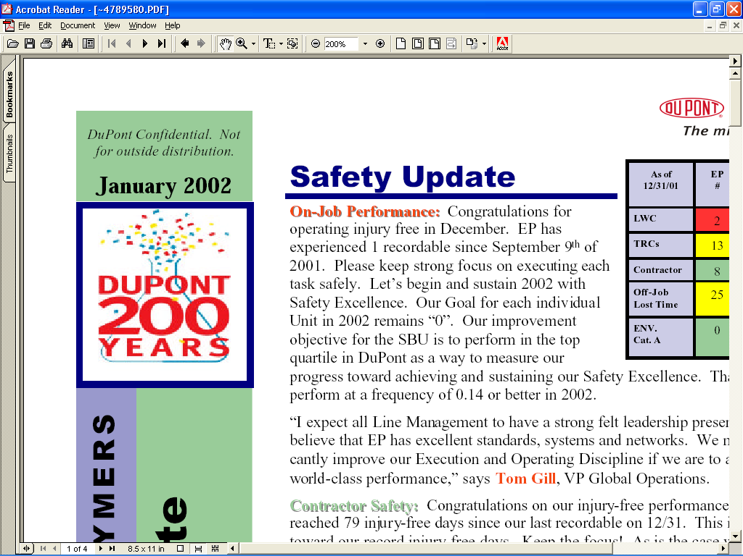
Transforming For Our Third Century
Maturity
Maturity
Growth
Maturity
Growth
Chemistry,
Biology. . .
Knowledge -
Intensive
Solutions
Birth
Growth
Birth
Chemistry,
Energy
Birth
Explosives
Six Sigma
1802 1830 1850 1900 1925 1945 1990 2000 2050 2090
Notes:
DuPont has undergone three transformations in our nearly 202-year history.
We are now in our third transformation, which began in 1998.
Since then we have made major changes in our portfolio (e.g. Pioneer, Chemfirst, electronics, Griffin acquisitions; Conoco, DTI, DuPont Merck divestitures).
We have also made changes in how we work, adopting Six Sigma methodology across the company.
We need to accelerate the rate of transformation. The changes that are part of the launch of the “new” DuPont are designed to do that.

Slide 4
Five Growth Platforms
DuPont Agriculture & Nutrition
$4.5 B
$5.4 B
DuPont
Coatings
& Color Technologies
$5.0 B
$5.5 B
DuPont Electronic & Communication Technologies
$2.5 B
$2.9 B
DuPont Performance Materials
$4.9 B
$5.3 B
DuPont
Safety & Protection
$3.5 B
$4.1 B
DuPont
Textiles and Interiors
$6.6 B
Large Opportunities
Strong Capabilities
Sold April, 2004
Market Leadership
Sales figures updated for 2003 actual. Original figures were 2002. Overall a 13% increase in 2003 vs. 2002
Notes:
DuPont established five growth platforms in 2002. These platforms remain our engine of growth.
They are well positioned to address the essential quality of life needs outlined on the previous charts.
They also are well positioned to draw on DuPont’s unique capabilities in science, sustainability and ability to tackle the “big task.”
The chart updates sales figures for 2003 estimated actual v. 2002. This represents a 13% increase in sales year-over-year. (These figures exclude DTI.)
Looking ahead, our sales targets through 2010 are:
- 2002: $20B
- 2003: $23B
- 2004: $25B
- 2006: $30B
- 2010: $40B

Slide 5
A Six Sigma Foundation provides the Discipline to achieve success

Slide 6


The Beginning of Six Sigma in DuPont
Deployment began in February 1999 with a decision by DuPont CEO Chad Holliday and his key leaders
DuPont contracted with the Six Sigma Academy to provide initial deployment guidance and training
Six Sigma was seen as a results driven process that has a track record of dramatically improving productivity the “right” way, by removing defects
Notes:
This chart illustrates the deployment of six sigma primarily aimed at individual improvement projects to take out cost.

Slide 7
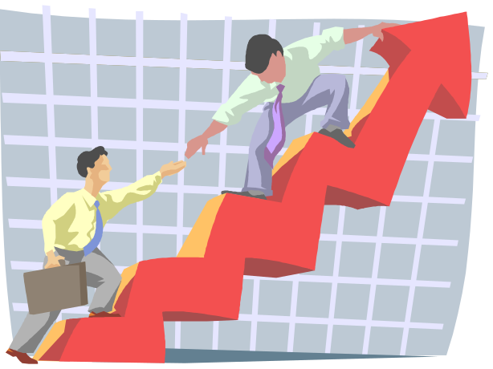
DuPont has been building a
Six Sigma Foundation
Transformation 2004
Marketing & Sales Effectiveness
Operations Supply Chain
Process Excellence 2003
Identified corporate core processes
Top Line Growth, DfSS 2002
900 DfSS, $1.2Bn revenue TLG projects 03
Green Belts- 6000 at the end of 2001
16000 trained by year end 2003
Black Belts and MBBs- 1200 at the end of 2000
2500 BBs, 300 MBBs trained by year end 2003
Notes:
Each year the focus of six sigma was broadened to take improvement to the next level. Each new layer built on the past years work but was intended to extend, not replace what was done in prior years.

Slide 8
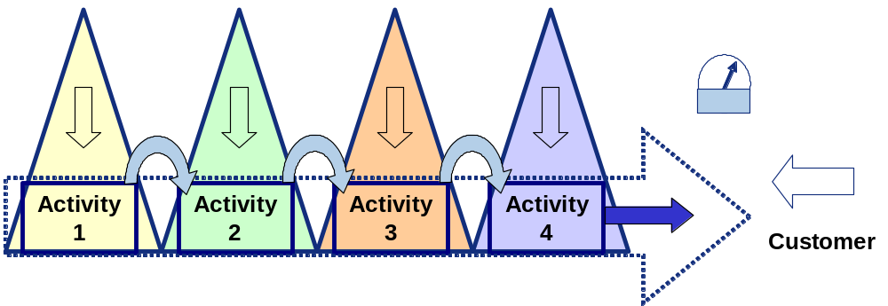
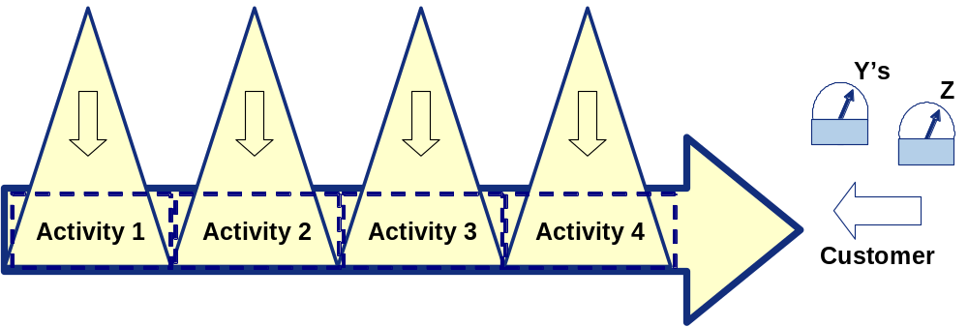
What’s the Problem with Today’s Change Process?
Managed by Activity
Our six sigma projects have achieved impressive results, one project at a time
However, in many cases, the overall process has not improved enough to meet customer needs and deliver required results
Managed by End-to-End Process
Focus on the overall process Y’s and Z’s to insure that the process meets business and customer requirements
The end to end process chosen by DuPont Operations as the transformational target is the end to end supply chain
Notes:
Illustrates the new dimension brought to the six sigma project by project approach by end to end process management. With an individual project focus, we were not sure the end to end process was improved by the many independent small projects aimed at taking out cost.

Slide 9
Systems support end to end business processes
The power of an ERP systems is in the integration, not in individual component functional excellence
DuPont started its SAP journey before it began six sigma (the first projects were kicked off 7 years ago) as discrete, business by business projects… a one DuPont, end to end process view was not envisioned
Most of the business cases were based on transactional and inventory benefits from better data and improved business processes, but….
  The improvement process must consider and deal with the complexity of partially installed ERP plus legacy environment that will exist for years
  ERP systems manage flow… material, information, dollars; the primary end to end process where the opportunity exists is supply chain
Notes:
SAP brought the ability to see process performance across many dimensions… region, globe, business, etc. This enables end to end process improvement much more than prior legacy systems that offered non- integrated, backward looking data.

Slide 10

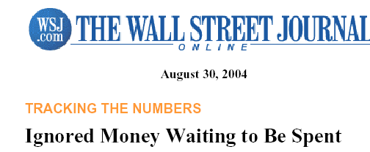
The world has changed…
Power has shifted from the manufacturers controlling the supply chain to “point of sale” control
The new battle front is supply chain to supply chain
Industry Week notes that with the consumer in the supply chain drivers seat, companies such as P&G are transforming themselves to meet the new challenge. Retailers such as Wal-Mart are forcing change in everything from how consumers buy to how products are manufactured and distributed.
The Wall Street Journal notes that there is $600Bn in working capital waiting to be spent by US companies and that industry leaders like Wal-Mart, P&G, Gillette, and 3M are making huge strides to free it up. Others, notably Dell, are already industry leaders and continue to drive WC as a competitive advantage.

Slide 11
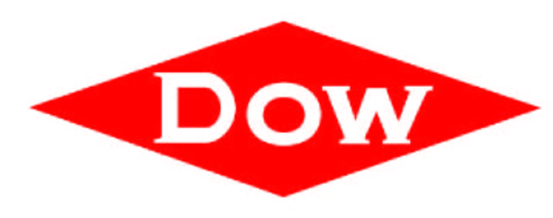









We Benchmarked the Supply Chain Performance of Excellent Companies
Notes:
We chose companies that our leaders respect. Peer companies in like industries suggested our performance entitlement. Companies in other industries showed ways to go beyond current entitlement to a new level of performance for our industry.

Slide 12
We cannot show the Detailed Data, but…
The data showed that DuPont invests significantly more than its peers in like industries in working capital invested per dollar of revenue
The practices of peer company leaders and other industry leaders were critical to identifying the supply chain critical x’s that DuPont needs to manage to also become excellent
The performance opportunity convinced DuPont leadership to support supply chain transformation across all of our businesses and to pursue a significant inventory reduction of at least a $Bn plus removing the associated carrying costs

Slide 13
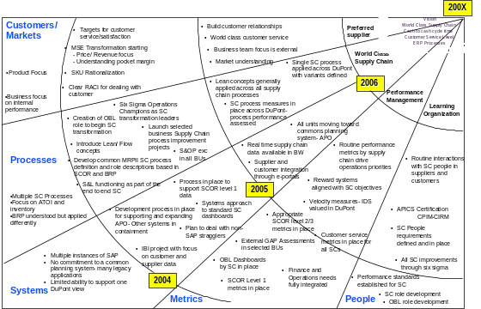
Operations Strategy - CTQ flowdown
Sustainable Growth
Create Demand
Create Demand
Fulfill Demand
Fulfill Demand
SC Transformation
Operations Basics
Strategy
People
Execution
Notes:
There are two basic processes; we will discuss fulfill demand which is primarily led by operations. The operations basics are delivering the current offering with excellence, while supply chain is the transformational direction for operations.

Slide 14
Supply Chain Transformation is about…
Improving end to end supply chain process capability to execute business plans and deliver customer expectations
  It is not about reducing inventory, but will reduce the need for inventory and associated hidden costs
  It will also reduce overall supply chain management costs and variable costs

Slide 15

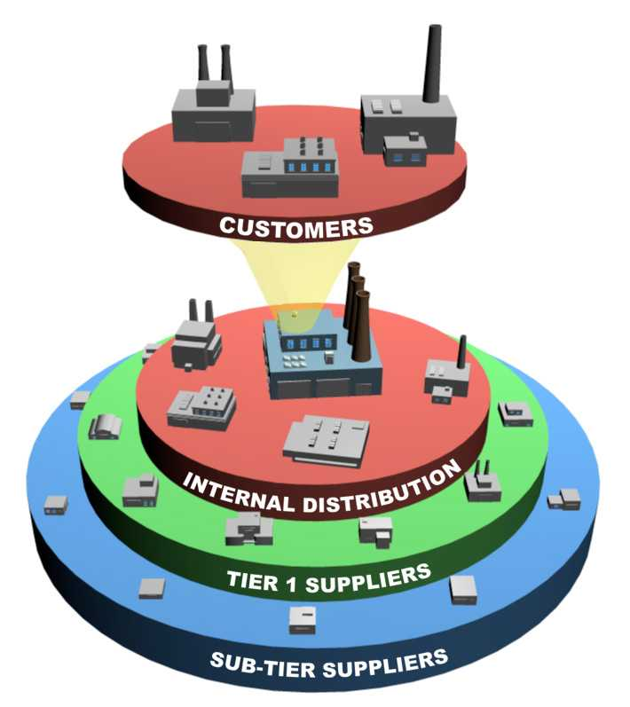
All companies studied use disciplined improvement, focused on flow, applied to the end to end Supply Chain Process
Six Sigma
Speed of improvement
Variation reduction
“How” Problems are Solved
Continuous Improvement
Y
= f (
X
, ... ,
X
= f (
= f (
X
X
, ... ,
, ... ,
X
1
X
)
1
N
N
μ
σ
Lean
Fully utilizing IT capabilities
Supply Chain
Speed in the value chain
Waste elimination
Value stream redesign
Pull versus Push
Optimization of Process, Policy, Organization, and Systems- SCOR
Once the supply chain is optimized, the discipline built into the ERP System locks in the Control Plan

Slide 16
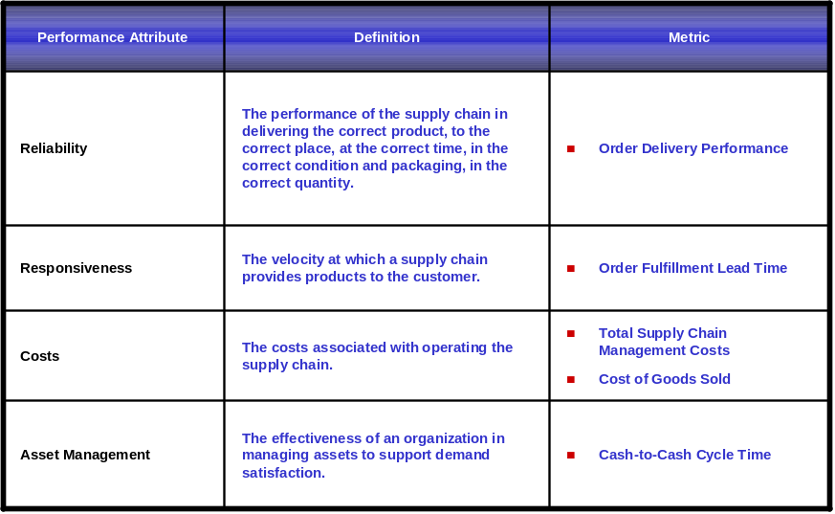
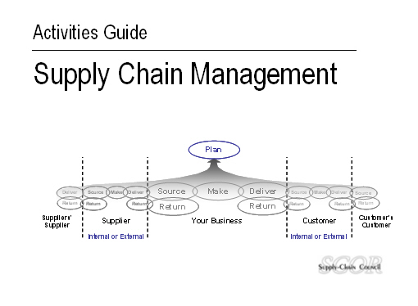
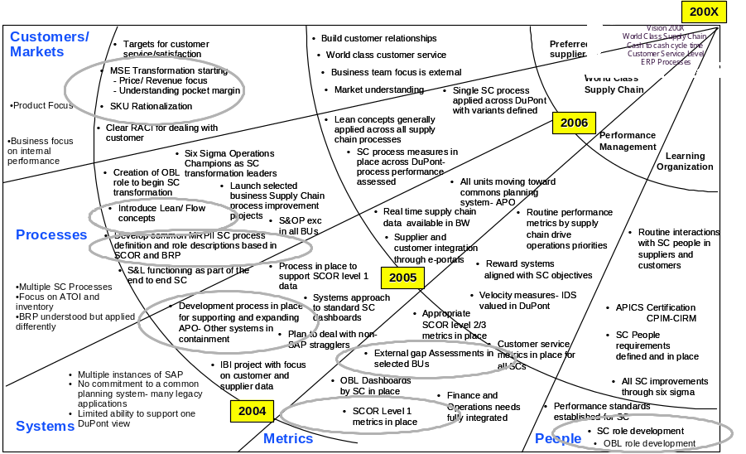
Supply Chain transformation has Four Basic Elements
Structure to Support
Common Metrics- Business Benchmarks
Change
Business
Business
Connect
Connect
Process
Process
System
System
OBL
OBL
Structure
Structure
Defined Best Practices
Integrated Transformation Elements

Slide 17
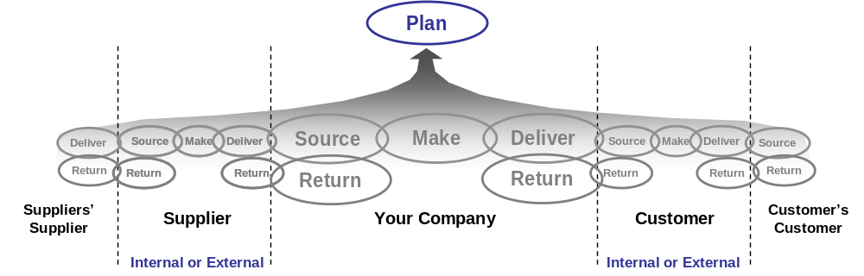

The SCOR Process Framework forms the basis of our common supply chain process definition
Supply Chain Operations Reference Model
Building Block Approach
Processes Metrics
Best Practice Technology

Slide 18
A Transformation Map Holistically Represents SC Transformation across several Years
Vision
World Class Supply Chain
Cash to cash cycle time
Customer Service Level
ERP Processes
Customers/
Markets
World class customer service
Preferred
supplier
Marketing and sales effectiveness six sigma projects
Business team focus is external
Market understanding
Product line simplification six sigma projects
World Class
Supply Chain
Product Focus
2005 six sigma projects to implement standard supply chain processes and implement lean in all businesses
2006
Business focus on internal performance
Performance Management
Learning Organization
Apply lean and six sigma improvement methodology to supply chain
Six Sigma projects to standardize supply chain support and planning systems
Develop supply chain end to end process definitions based on SCOR
Processes
Supply chain process capability improvement projects
Six Sigma projects to create standard supply chain performance dashboards and transformation metrics
2005
Multiple SC Processes
Focus on ATOI and inventory
BRP understood but applied differently
Six sigma projects to develop required systems capability to support end to end supply chain performance metrics
Appropriate SCOR level 2/3 metrics in place
Supply Chain performance standards in place for all supply chain roles
APICS or other people capability certification in place
Develop common supply chain planning software
External gap Assessments using peer performance comparisons
Multiple instances of SAP
No commitment to a common planning system- many legacy applications
Limited ability to support one company view
2004
SC Performance dashboards in place
SCOR Level 1 metrics in place
Development plans in place for supply chain professionals
Systems
Metrics
People
Notes:
The destination is the starburst articulated as World Class Supply Chain. It has two dimensions represented by customer service level (the customer experience) and cash cycle (velocity). Work takes place in the 5 workstream areasand have elements to be completed in 2004 and 2005.

Slide 19
Corporate Project Charter
DuPont Operations is chartered to improve Supply Chain performance in DuPont businesses
  Define current supply chains and benchmark performance vs SCOR (industry standard) definitions to develop gap by business/ supply chain
  Assess current Supply Chain practices and improve to best MRPII process entitlement
  Introduce lean/ flow concepts to improve process capability to manage inventory and supply chain management costs beyond industry average toward best in class entitlement as determined by business industry positioning
Notes:
The three elements of the work are Define the supply chains in terms of metrics, assess and insure disciplines are in place to execute well, and then bring in the element of flow. You cannot skip the discipline step without risking harm to your customers.

Slide 20
Supply Chain Transformation- A view of the journey
Stage 1: Capture the Imagination… show what is possible
Hold mindshare through the journey
Stage 2: Establish the Infrastructure to Execute
Roles in place
Metrics- SCOR level 1
PMO- 6S Champions
Capability- Lean/SC training
MRP II Basics- Common Process
Data Disciplines in place
Maturity Diagnostic
Stage 3: Build the basic Foundational Disciplines
Lean Flow Pilots
Extending the Learnings
All change thru Six Sigma Projects
Stage 4: Change the Game- Pilot Projects
Notes:
We probably are mostly complete on phase 1, mostly through phase 2, no more than halfway through phase 3 and just starting phase 4.

Slide 21
One DuPont SC Projects Underway
Transformation Project Management Office to guide the change process
Development of the structure to support Transformation
SCOR Level One Metrics
Supply Chain Common Process Definition
SAP Systems integration, legacy system reduction
Lean tool addition to our Six Sigma deployment
SAP/ APO pilot development
APICS Certification Process for SC Professionals
Platform Supply Chain kickoff meetings

Slide 22
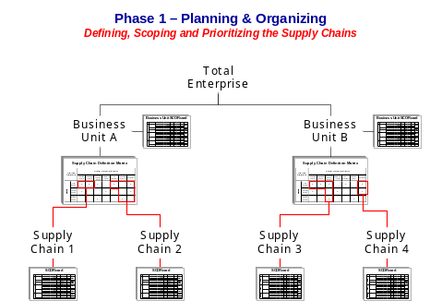
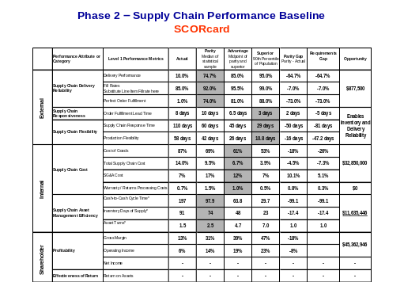
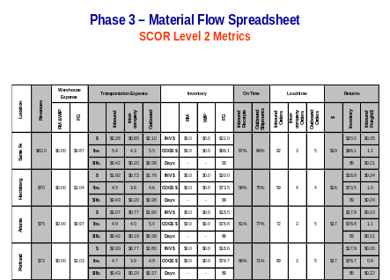
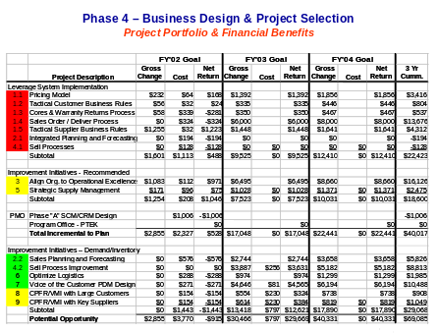
Getting Projects Started…
Phase 0
D
Phase 1A
M
Phase 1B
AI
Phase 1C
C
Define and prioritize
the unique Supply Chains in your business
Value Stream Mapping
Measure and benchmark
performance in your Supply
Chain versus your competition to identify the performance improvement “gaps” ….
Analyze the material, work,
and information flows in the
Supply Chain to identify the
improvement projects that
need to be executed to
close the “gaps” ….
Financial validate all
projects in the Project
Portfolio; prioritize, charter,and launch the projects using Lean, Six Sigma and SAP/IT Experts to capture the benefits!
Start with defining the
Supply chains
Benchmark and
assess the gap

Slide 23

m

